Slide 1


Invertibility Conditions for Floating Point Formulas
Aina Niemetz
Mathias Preiner
Clark Barrett
Andrew Reynolds
Cesare Tinelli
Martin Brain

Slide 2
SMT Solvers for Quantifiers + Floating Points
Floating point reasoning in SMT is hard
  Bit-blasting [Brillout et al 2009, Brain et al 2019]
  Interval techniques [Brain et al 2014, Marre et al 2017]
Quantified reasoning in SMT is hard
  Heuristic instantiation techniques [deMoura et al 2007]
  Model-based instantiation for finite domains [Wintersteiger et al 2013]
Floating Point + Quantified reasoning in SMT is very hard!
  …no existing works to our knowledge, despite potential applications
    Proving safety properties, synthesizing bounding polynomials, …

Slide 3

In This Talk:
Towards solving quantified floating points via Invertibility Conditions
  Extends approach for quantified bit-vectors [Niemetz et al CAV 18]
Goal: establish invertibility conditions for theory of floating points
  Developed custom synthesis framework on top of CVC4_{SY}
Preliminary evidence that ICs are useful for solving ∀FP formulas

Slide 4
What is an invertibility condition?
Given equation :
∃x. x⊕s~t
  An invertibility condition is a predicate IC(s,t) that holds exactly when the above formula has a solution for x
For example:
  ∃x. x*2=t
  ∴ t%2=0 is an invertibility condition for this formula (assuming x,t are integers)

Slide 5
What can we do with Invertibility Conditions?
Invertibility conditions can be used for:
  Local search techniques [Niemetz et al CAV 2016]
    Accelerate search for satisfiable q.f. inputs
  Solving quantified formulas
    Quantifier elimination
      ∃x. x⊕s~t ⇔ IC(s,t)
    Quantifier instantiation
      ∀x. (¬x⊕s~t ∨ P(x)) ⇒ (¬IC(s,t) ∨ P(k_{IC(s,t)}))

Slide 6
How do we find Invertibility Conditions?
Say I want to find invertibility condition for floating point equation:
  ∃IC. ∀st:FP_{e,s}. (∃x:FP_{e,s}.x⊕s~t) ⇔ I(s,t)

Slide 7
How do we find Invertibility Conditions?
Can express as a synthesis problem:
  ∃IC. ∀st:FP_{e,s}. (∃x:FP_{e,s}.x⊕s~t) ⇔ IC(s,t)
Can express as a synthesis problem:
…there exists a predicate IC that is equivalent to ∃x:FP_{e,s}.x⊕s~t

Slide 8

How do we find Invertibility Conditions?
Can express as a synthesis problem:
  ∃IC. ∀st:FP_{e,s}. (∃x:FP_{e,s}.x⊕s~t) ⇔ IC(s,t)
… solve via syntax-guided synthesis (SyGuS) solver CVC4_{SY} ?
?
SY

Slide 9
How do we find Invertibility Conditions?
Can express as a synthesis problem:
  ∃IC. ∀st:FP_{e,s}. (∃x:FP_{e,s}.x⊕s~t) ⇔ IC(s,t)
Challenge #1: problem is parameteric
  Parameterized by # exponent bits e, # significant bits s

Slide 10
How do we find Invertibility Conditions?
Can express as a synthesis problem:
  ∃IC. ∀st:FP_{3,5}. (∃x:FP_{3,5}.x⊕s~t) ⇔ IC(s,t)
Challenge #1: problem is parameteric
⇒ Solve for a fixed format, check if solution generalizes [Niemetz et al CAV 2018]
  Choose e=3, s=5 … large enough to exhibit FP behaviors, small enough for synthesis to scale

Slide 11
How do we find Invertibility Conditions?
Can express as a synthesis problem:
  ∃IC. ∀st:FP_{3,5}. (∃x:FP_{3,5}.x⊕s~t) ⇔ IC(s,t)

Slide 12
How do we find Invertibility Conditions?
Can express as a synthesis problem:
  ∃IC. ∀st:FP_{3,5}. (∃x:FP_{3,5}.x⊕s~t) ⇔ IC(s,t)
Challenge #2: problem has three levels of quantifier alternation
  …SyGuS solvers only typically handle two

Slide 13
How do we find Invertibility Conditions?
Can express as a synthesis problem:
  ∃IC. ∀st:FP_{3,5}. (∃x:FP,c⊕s~t ) ⇔ IC(s,t)
Challenge #2: problem has three levels of quantifier alternation
Expand the innermost quantifier [Niemetz et al CAV 2018]
  Since domain is (relatively) small and finite
    Only 227 values for FP_{3,5}
227
∨
c=1

Slide 14
How do we find Invertibility Conditions?
Can express as a synthesis problem:
  ∃IC. ∀st:FP_{3,5}. (∃x:FP,c⊕s~t ) ⇔ IC(s,t)
Challenge #3
227
∨
c=1
…can now give as input to SyGuS solver

Slide 15

How do we find Invertibility Conditions?
Can express as a synthesis problem:
  ∃IC. ∀st:FP_{3,5}. (∃x:FP,c⊕s~t ) ⇔ IC(s,t)
Challenge #3: Scalability!
  With respect to BV synthesis @ 4 bits [Niemetz et al CAV 2018]:
    Roughly 14 times more constraints, q.f. FP is much harder than BV
227
∨
c=1
SY

Slide 16
How do we find Invertibility Conditions?
Can express as a synthesis problem:
  ∃IC. ∀st:FP_{3,5}. (∃x:FP,c⊕s~t ) ⇔ IC(s,t)
Challenge #3: Scalability
227
∨
c=1

Slide 17
How do we find Invertibility Conditions?
227 227
∧ ∧
s=1 t=1
Can express as a synthesis problem:
  ∃IC. ∀st:FP_{3,5}c_{s,t} ⇔ IC(s,t)
Challenge #3: Scalability
  Statically compute the I/O behavior of entire domain of IC(s,t)
    Each c_{s,t} is determined by a quantifier-free satisfiability query
      227*227 = 51529, takes ~10 minutes27 = 51529 sat queries to compute for 2-dimensions of FP_{3,5} time for formats considered in this paper
∃x.x*s=t? where s, t are constants

Slide 18
How do we find Invertibility Conditions?
227 227
∧ ∧
s=1 t=1
Can express as a synthesis problem:
  ∃IC. ∀st:FP_{3,5}c_{s,t} ⇔ IC(s,t)

Slide 19
How do we find Invertibility Conditions?
227 227
∧ ∧
s=1 t=1
Can express as a synthesis problem:
  ∃IC. ∀st:FP_{3,5}c_{s,t} ⇔ IC(s,t)
Sample
c_{1,2} ⇔ IC(1,2)
c_{3,7} ⇔ IC(3,7)
c_{1,7} ⇔ IC(1,7)
…
SY
Candidate Solutions

Slide 20
How do we find Invertibility Conditions?
227 227
∧ ∧
s=1 t=1
Can express as a synthesis problem:
  ∃IC. ∀st:FP_{3,5}c_{s,t} ⇔ IC(s,t)
Test (Fast!)
Sample
c_{1,2} ⇔ IC(1,2)
c_{3,7} ⇔ IC(3,7)
c_{1,7} ⇔ IC(1,7)
…
SY
Candidate Solutions

Slide 21

How do we find Invertibility Conditions?
227 227
∧ ∧
s=1 t=1
Can express as a synthesis problem:
  ∃IC. ∀st:FP_{3,5}c_{s,t} ⇔ IC(s,t)
Sample
c_{1,2} ⇔ IC(1,2)
c_{3,7} ⇔ IC(3,7)
c_{1,7} ⇔ IC(1,7)
…
SY
Candidate Solutions
“User in the loop”

Slide 22
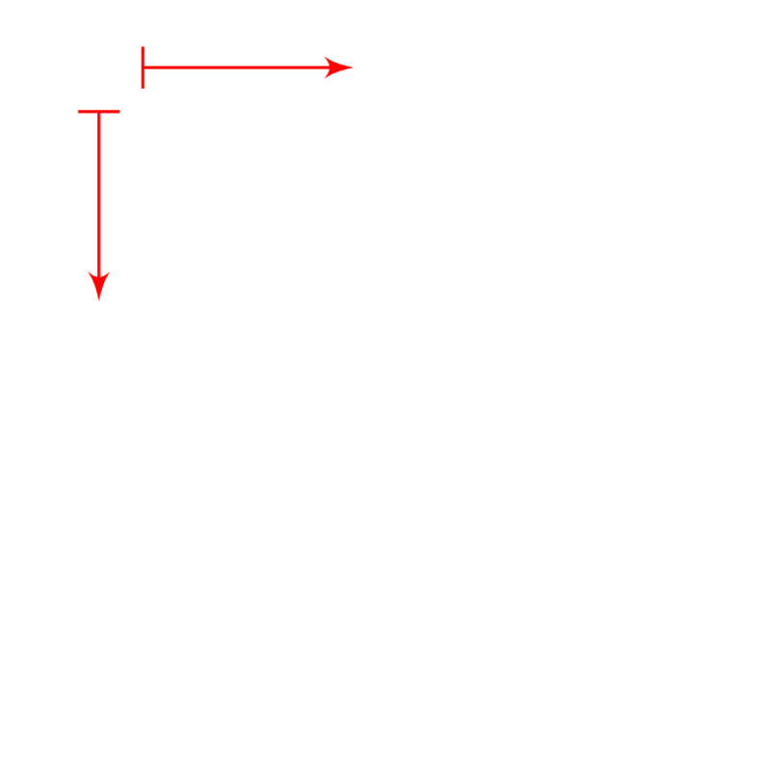
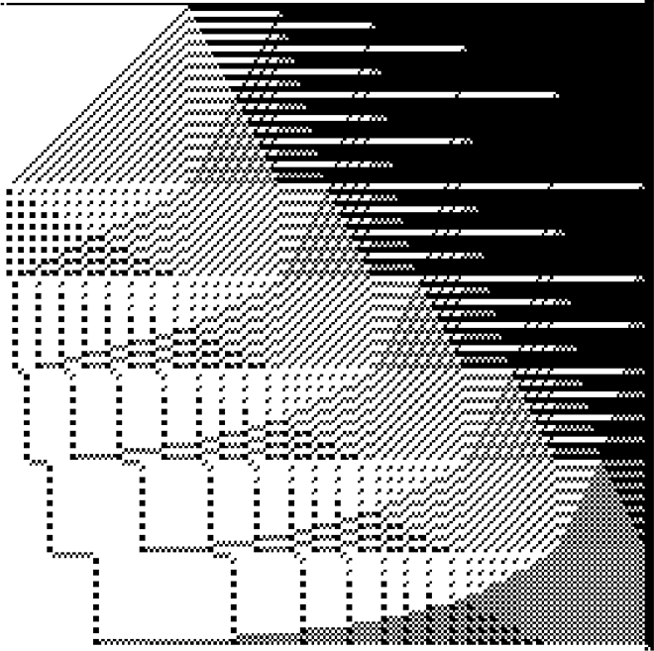
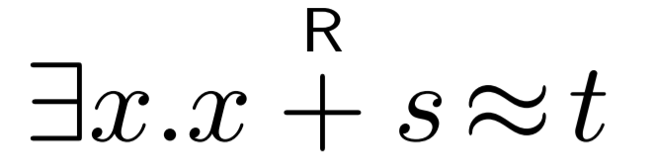
Visualizing I/O Specs of Invertibility Conditions
s
t=±0
t
sub-normal t
227 227
∧ ∧
s=1 t=1
Can express as a synthesis problem:
  ∃IC. ∀st:FP_{3,5}c_{s,t} ⇔ IC(s,t)
normal t
t=±∞
t=NaN
White = IC is true, Black = IC is false
  ⇒ Behavior of IC is highly complex!

Slide 23
Synthesizing Invertibility Conditions
SY

Slide 24
Synthesizing Invertibility Conditions
“Full I/O Specification for IC”
(Verifier)
(Synthesizer)
SY

Slide 25

Synthesizing Invertibility Conditions
Initial Examples
C
Red = Counterexample not specified
SY

Slide 26



Synthesizing Invertibility Conditions
IC₁(s,t)
SY

Slide 27
Synthesizing Invertibility Conditions
Counterexamples
C,C₁
Test
SY

Slide 28


Synthesizing Invertibility Conditions
Counterexamples
C,C_{1,}C₂
IC₂(s,t)
SY

Slide 29


Synthesizing Invertibility Conditions
Counterexamples
C,C_{1,}C_{2,}C₃
IC₃(s,t)
SY

Slide 30


Synthesizing Invertibility Conditions
Counterexamples
C,C_{1,}C_{2,}C_{3,}C₄
IC₄(s,t)
SY

Slide 31


Synthesizing Invertibility Conditions
Counterexamples
C,C_{1,}C_{2,}C_{3,}C_{4,}C₅
IC₅(s,t)
SY

Slide 32
Synthesizing Invertibility Conditions
Counterexamples
C,C_{1,}C_{2,}C_{3,}C_{4,}C_{5,}C₆
SY

Slide 33

Synthesizing Invertibility Conditions
Counterexamples
C,C_{1,}C_{2,}C_{3,}C_{4,}C_{5,}C₆
SY

Slide 34
Synthesizing Invertibility Conditions
Counterexamples
{ C | s.t. SC}
User may control:
Grammar G for synthesizer
“Side condition” SC for verifier
?
IC(s,t)∈G
SY

Slide 35
Finding Invertibility Conditions: Results
In total, found 167 of 188 conditions

Slide 36
Finding Invertibility Conditions: Results
In total, found 167 of 188 conditions
  14 choices for argument positions of ⊕
    add₁, sub_{1,2}, mult_{1,} div_{1,2}, rem_{1,2}, fma_{1,3}, sqrt₁, abs₁, neg₁, roundToIntegral₁
  13 choices for ~
    =, ≠, ≥, >, <, ≤, isNormal, isSubnormal, isZero, isInfinite, isNaN, isPositive, isNegative
  7 additional ICs for equations with only a relation, e.g. x>t
  ⇒ 14*13 + 7 = 188
    When applicable, ICs hold for each 5 rounding modes {RNE, RNA, RTP, RTN, RTZ} of operator
x⊕s~t

Slide 37
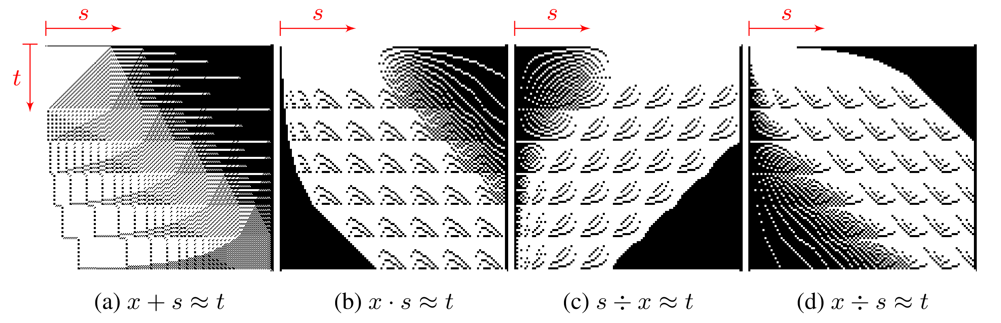
Finding Invertibility Conditions: Results
In total, found 167 of 188 conditions

Slide 38
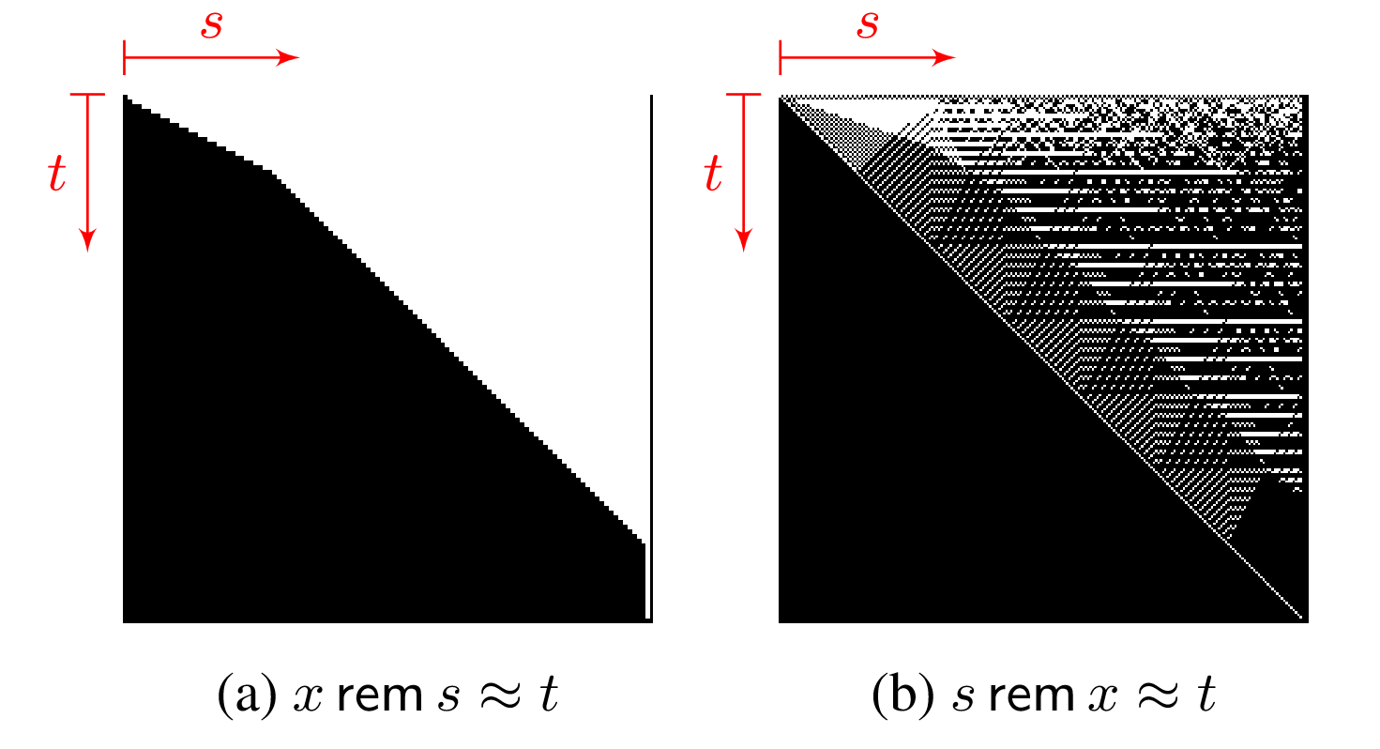
Finding Invertibility Conditions: Results
Others were hard to find
???
…behavior is pseudo-random!

Slide 39
Do Invertibility Conditions hold for all FP Formats?
We checked all 167 invertibility conditions on other FP Formats
  Targeted formats FP_{3,5}, FP_{4,5}, FP_{4,6}, FP_{5,11}, FP_{8,24}, FP_{11,53}
  All invertibility conditions (appear to) generalize to all formats
    Successful in 94.5% of the above cases using CVC4, Z3 (failures due to timeouts)
    Approximately 32 days of compute time
Future work: Format-Independent Verification!

Slide 40
What can we do with Invertibility Conditions?
Floating point invertibility conditions can be used for:
  ⇒ In this paper: Quantifier Elimination
    Currently limited to “linear” (single variable) quantified floating points
    Preliminary work in this paper:
      Implemented prototype preprocessing pass in CVC4 leveraging ICs
        Led to +7 / 56 quantified FP verification benchmarks from SMT LIB

Slide 41
What can we do with Invertibility Conditions?
Summary of intuition:

Slide 42
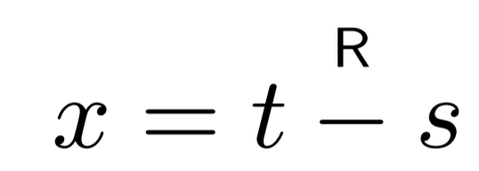
What can we do with Invertibility Conditions?
Summary of intuition:
Try inverse in rounding mode R?

Slide 43
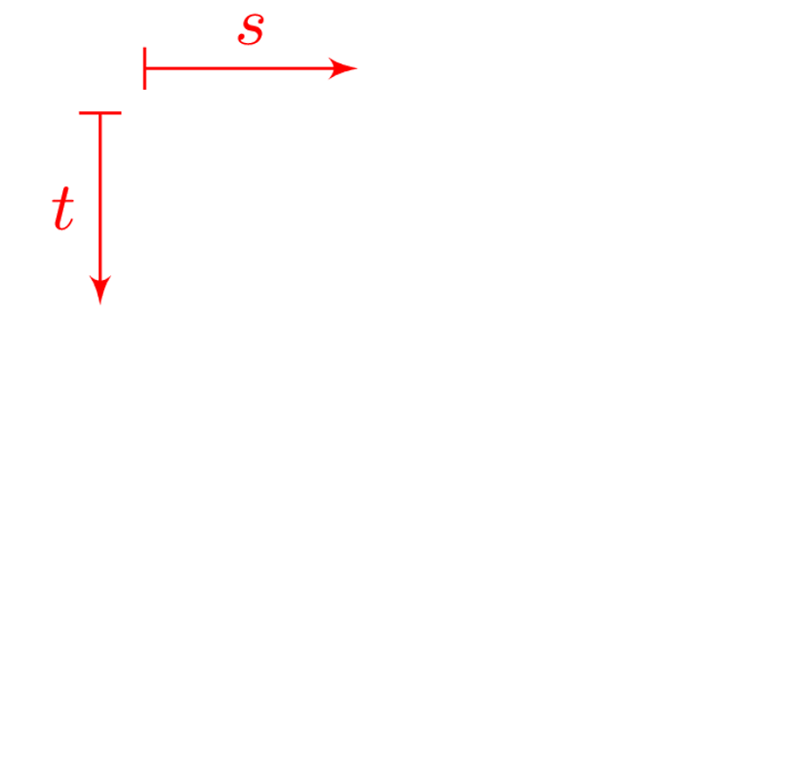

What can we do with Invertibility Conditions?
Summary of intuition:
…
Try inverse in rounding mode R?
…
red = wrong (showing R=RNE)

Slide 44
What can we do with Invertibility Conditions?
Summary of intuition:

Slide 45
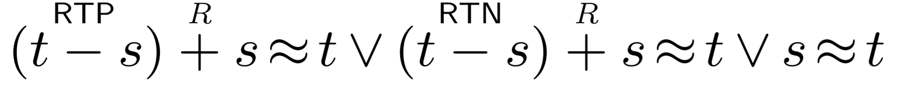
What can we do with Invertibility Conditions?
Summary of intuition:
⇔

Slide 46
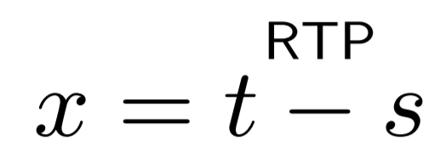
What can we do with Invertibility Conditions?
Summary of intuition:
⇔
Try rounding towards positive

Slide 47
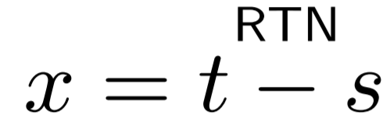
What can we do with Invertibility Conditions?
Summary of intuition:
⇔
Try rounding towards positive
Try rounding towards negative

Slide 48
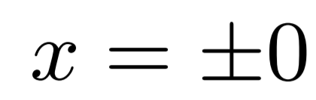
What can we do with Invertibility Conditions?
Summary of intuition:
⇔
Try rounding towards positive
Try rounding towards negative
Corner case, try zero

Slide 49
What can we do with Invertibility Conditions?
Similar intuition for many other invertibility conditions:
      Equation Set of Possible Solutions
corner cases for
±0, ±∞, NaN
+

Slide 50
Ongoing Work
Integrate invertibility conditions into quantifier instantiation in CVC4
Format-independent verification of invertibility conditions
  “Towards Bit-Width Independent Proofs in SMT Solvers” [Niemetz et al CADE 2019]
Tackle harder synthesis problems using our synthesis framework:
  Equations that are “non-linear”, e.g. x*x=t
  Invertibility conditions that have 3+ dimensions
    ...

Slide 51


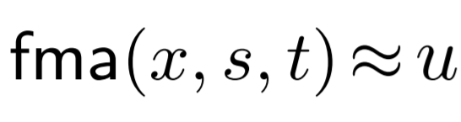
Ongoing Work
: time
FP equations having 3+ dimensions
  Fused multiply-add with equality
Thanks for Listening!

